Slide 1

Work-let Name: Vector implementation of 3D convolution on CV32E40P core by OpenHW
Worklet Details
Worklet ID: 24CT010CITB
College Name: Cambridge Institute of Technology
Successful implementation of vector 3D convolution on CV32E40P core.
Verification of Results through simulation and testing.
Challenges or issues faced during the implementation
i.e Debugging
KPIs achieved till now
Any Challenges/ Issues faced
Next Steps
Further optimization
Integration with OpenHW
Succesfull implementation of 3D convolution.
Verification and testing using Pulp simulator.
Key Achievements/ Outcome till now
Date: 21-04-2025

Slide 2
Work-let Name: Vector implementation of 3D convolution on CV32E40P core by OpenHW
Worklet Details
Worklet ID: 24CT010CITB
College Name: Cambridge institute of Technology
Resource Requirement Identified with Status
Access to GCC toolchain for RISC-V and system libraries
Power profiling tools (if hardware is used)
Github Repository Link and PRISM Portal Registration Status
Samsung prism registration is done waiting for approval
Github link waiting for access
Any Anticipated Break (Due to exams etc)
Lab internal scheduled on 24/04/25
Internal scheduled on 23/05/25 to 26/05/25
Kernel sliding data is self-collected
No dataset used; self-implemented kernel validated with synthetic 3D inputs
Data Collection Information
Date: 21-04-2025

Slide 3
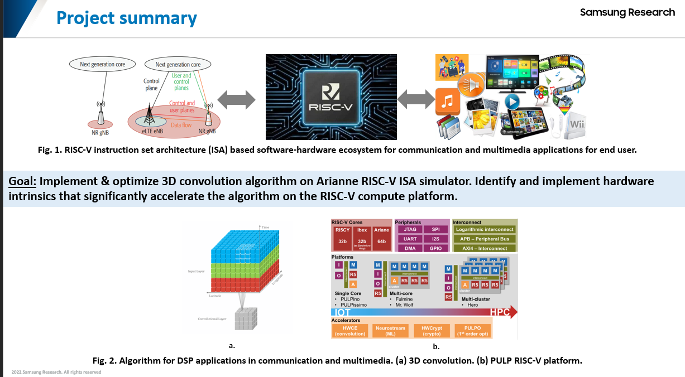
Work-let Name: Vector implementation of 3D convolution on CV32E40P core by OpenHW
Worklet Details
Worklet ID: 24CT010CITB
College Name: Cambridge institute of Technology
Date: 21-04-2025

Slide 4
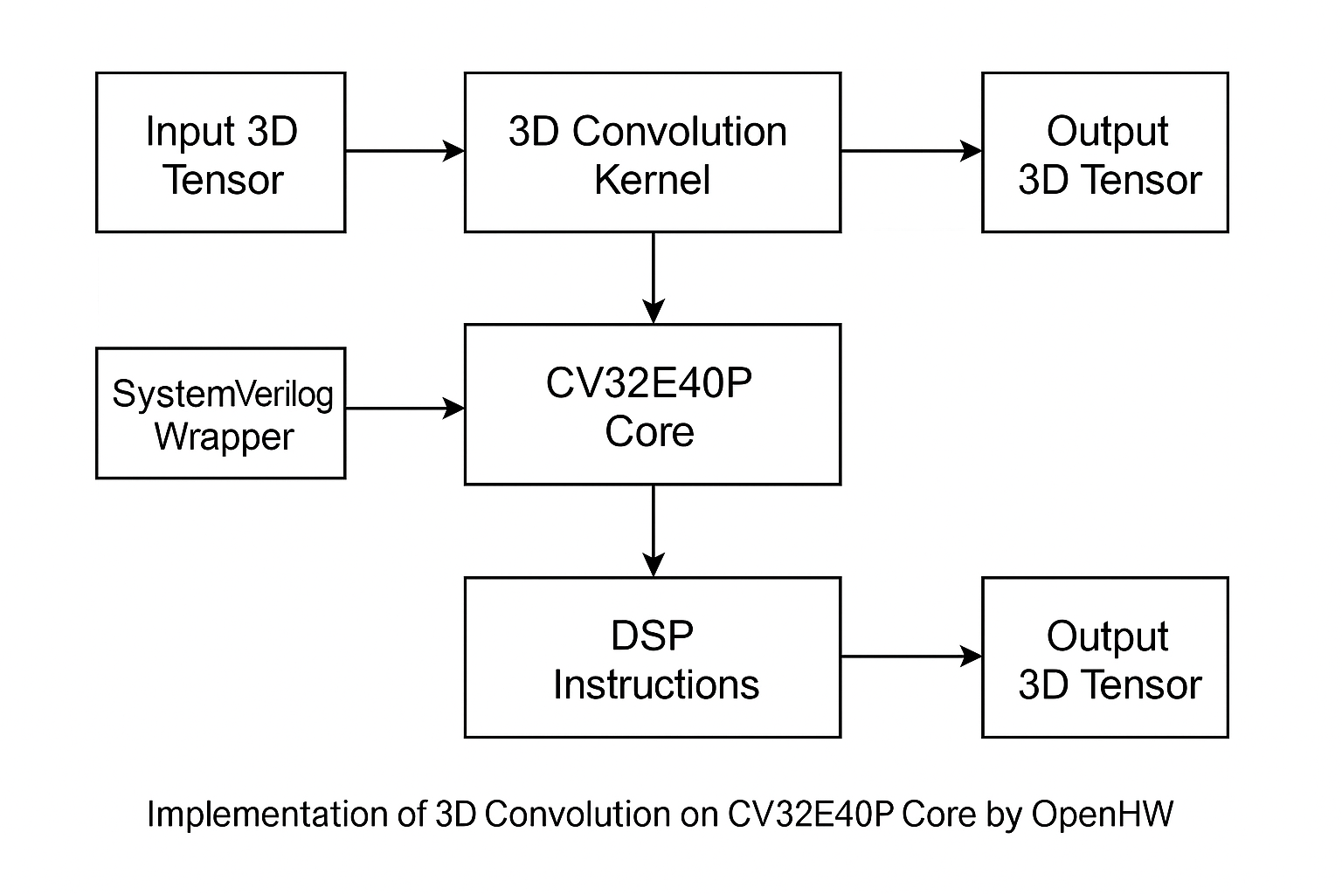
Work-let Name: Vector implementation of 3D convolution on CV32E40P core by OpenHW
Worklet Details
Worklet ID: 24CT010CITB
College Name: Cambridge institute of Technology
BLOCK DIAGRAM
Date: 21-04-2025

Slide 5
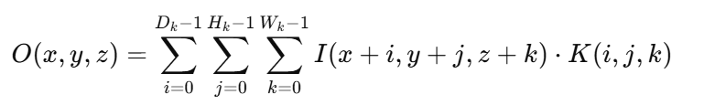
Work-let Name: Vector implementation of 3D convolution on CV32E40P core by OpenHW
Worklet Details
Worklet ID: 24CT010CITB
College Name: Cambridge institute of Technology
FORMULA :
The 3D convolution of an input volume I with a kernel K can be defined
Where:
I is the input volume (3D)
K is the 3D kernel/filter
Dk​, Hk​, and Wk​ are the Depth, height, and width of the kernel
O(x,y,z) is the Output value at position (x,y,z)
Date: 21-04-2025

Slide 6
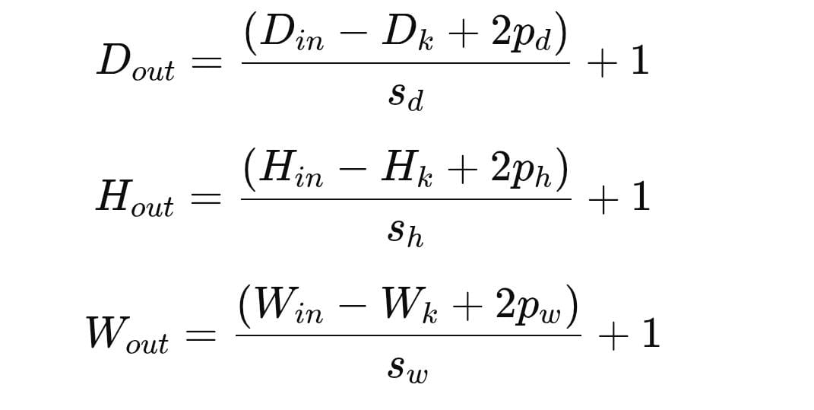
Work-let Name: Vector implementation of 3D convolution on CV32E40P core by OpenHW
Worklet Details
Worklet ID: 24CT010CITB
College Name: Cambridge institute of Technology
STEPS:
1. Apply Padding:
Extend the input tensor by adding zeros along the edges according to the padding values
2. Compute Output size:
Date: 21-04-2025

Slide 7
Work-let Name: Vector implementation of 3D convolution on CV32E40P core by OpenHW
Worklet Details
Worklet ID: 24CT010CITB
College Name: Cambridge institute of Technology
3D Convolution Algorithm:
Input tensor of size (D_in, H_in, W_in)
Kernel of size (D_k, H_k, W_k)
Stride = (s_d, s_h, s_w)
Padding = (p_d, p_h, p_w)
Date: 21-04-2025

Slide 8
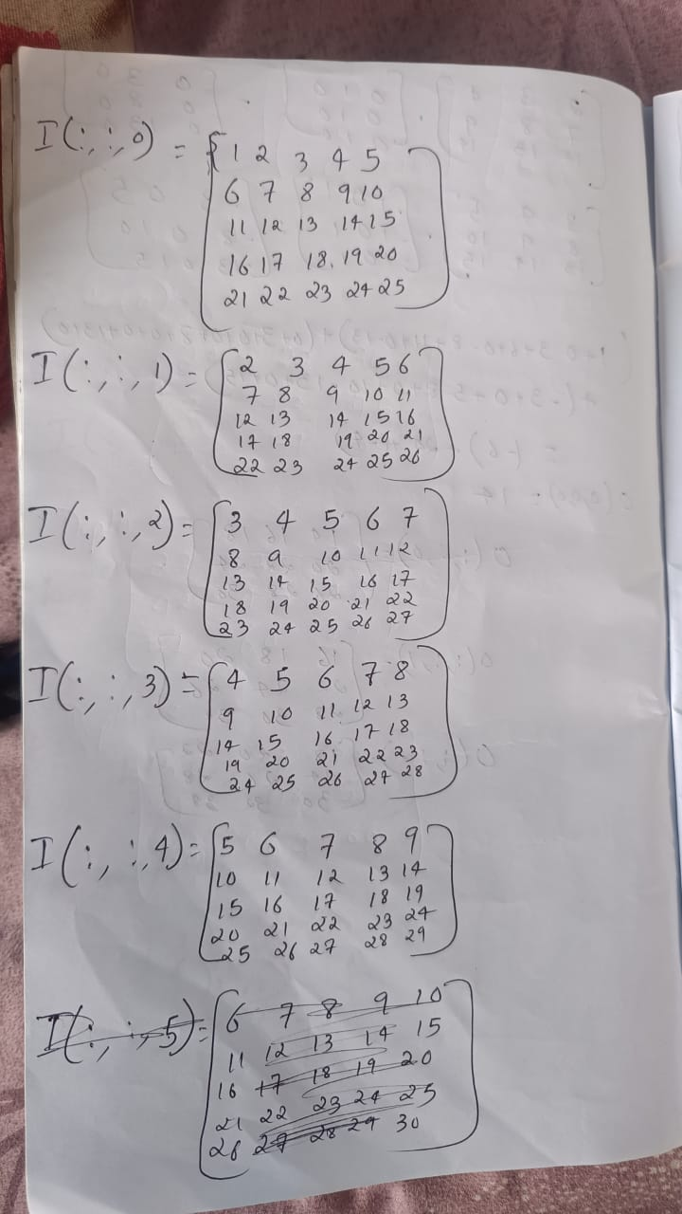
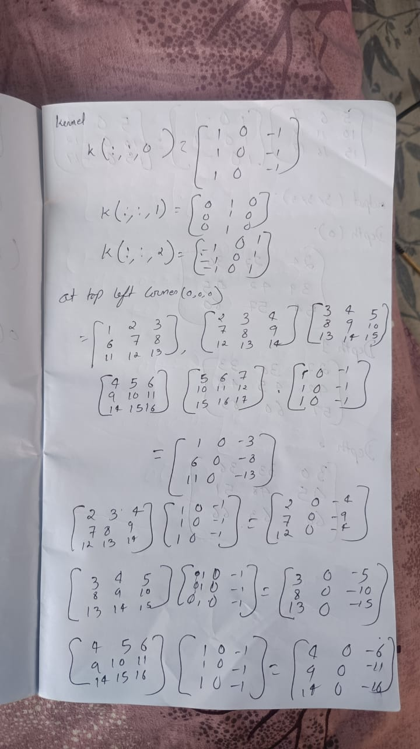
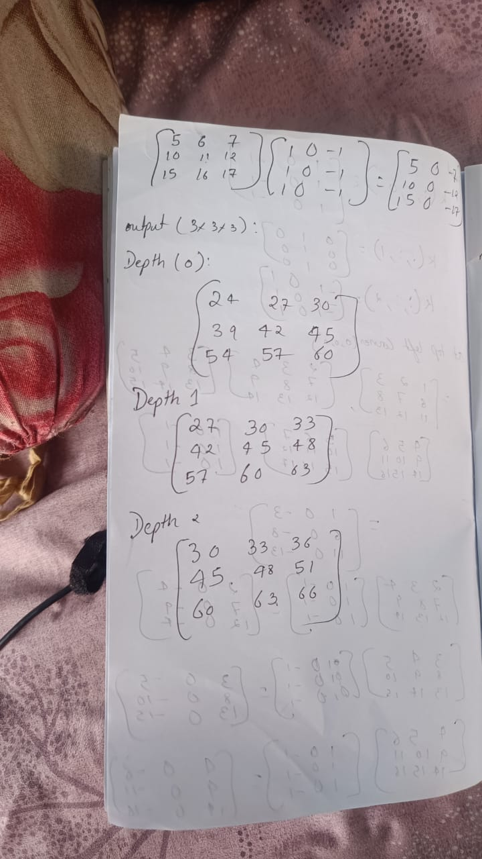
Work-let Name: Vector implementation of 3D convolution on CV32E40P core by OpenHW
Worklet Details
Worklet ID: 24CT010CITB
College Name: Cambridge institute of Technology
Kernel Sliding Method:
Date: 19-04-2025

Slide 9
Work-let Name: Vector implementation of 3D convolution on CV32E40P core by OpenHW
Worklet Details
Worklet ID: 24CT010CITB
College Name: Cambridge institute of Technology
Program:
#include <stdio.h>
#include<printf.h>
#define IN_SIZE 5#define KERNEL_SIZE 3
#define OUT_SIZE (IN_SIZE - KERNEL_SIZE + 1)
int main()
{
int input[IN_SIZE][IN_SIZE][IN_SIZE] = {
{
{1, 2, 3, 4, 5},
{6, 7, 8, 9, 10},
{11, 12, 13, 14, 15},
{16, 17, 18, 19, 20},
{21, 22, 23, 24, 25}
},
{
{2, 3, 4, 5, 6},
{7, 8, 9, 10, 11},
{12, 13, 14, 15, 16},
{17, 18, 19, 20, 21},
{22, 23, 24, 25, 26}
},
{
{3, 4, 5, 6, 7},
{8, 9, 10, 11, 12},
{13, 14, 15, 16, 17},
{18, 19, 20, 21, 22},
{23, 24, 25, 26, 27} },
{19, 20, 21, 22, 23},
{24, 25, 26, 27, 28} },
,{
{5, 6, 7, 8, 9},
{10, 11, 12, 13, 14},
{15, 16, 17, 18, 19},
{20, 21, 22, 23, 24},
{25, 26, 27, 28, 29} } };
int kernel[KERNEL_SIZE][KERNEL_SIZE][KERNEL_SIZE] = {
{
{1, 0, -1}, {1, 0, -1}, {1, 0, -1}
},
{
{0, 1, 0},
{0, 1, 0},
0, 1, 0} },
Date: 19-04-2025

Slide 10
Work-let Name: Vector implementation of 3D convolution on CV32E40P core by OpenHW
Worklet Details
Worklet ID: 24CT010CITB
College Name: Cambridge institute of Technology
Program:
{
{-1, 0, 1},
{-1, 0, 1},
{-1, 0, 1}
} };
int output[OUT_SIZE][OUT_SIZE][OUT_SIZE] = {0}; // 3D Convolution
for (int d = 0; d < OUT_SIZE; d++) {
for (int h = 0; h < OUT_SIZE; h++) {
for (int w = 0; w < OUT_SIZE; w++) {
int sum = 0;
for (int kd = 0; kd < KERNEL_SIZE; kd++) {
for (int kh = 0; kh < KERNEL_SIZE; kh++) {
for (int kw = 0; kw < KERNEL_SIZE; kw++) {
sum += input[d + kd][h + kh][w + kw] * kernel[kd][kh][kw];
}
}
}
output[d][h][w] = sum;
} } }
printf("Output Volume (3x3x3):\n");
for (int d = 0; d < OUT_SIZE; d++) {
printf("Depth %d:\n", d);
for (int h = 0; h < OUT_SIZE; h++) {
for (int w = 0; w < OUT_SIZE; w++) {
printf("%4d ", output[d][h][w]);
}
printf("\n"); }
printf("\n"); }
return 0;
}
Date: 19-04-2025

Slide 11
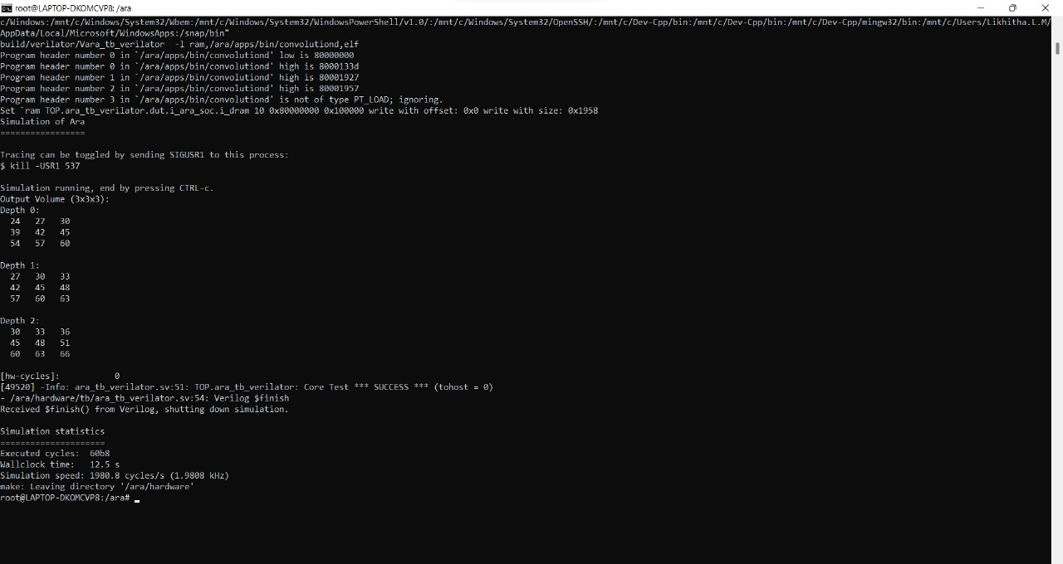
Work-let Name: Vector implementation of 3D convolution on CV32E40P core by OpenHW
Worklet Details
Worklet ID: 24CT010CITB
College Name: Cambridge institute of Technology
Output:
Date: 19-04-2025

Slide 12
Work-let Name: Vector implementation of 3D convolution on CV32E40P core by OpenHW
Worklet Details
Worklet ID: 24CT010CITB
College Name: Cambridge institute of Technology
Output:
Executed cycles | Wall clock time | Simulation speed | frequency
24760 | 12.5 s | 1980.8 | 1.9808 kHz
Date: 19-04-2025

Slide 13
Work-let Name: Vector implementation of 3D convolution on CV32E40P core by OpenHW
Worklet Details
Worklet ID: 24CT010CITB
College Name: Cambridge institute of Technology
Status and future plan : 3D convolution algorithm was analysed mathematically and tested the program.
Students have learnt the PULP tool for RISC V.
Latest Literature Review: NA
Professor Comments (To be filled in and presented by professor (Either)
Google collab(GITHUB)
COMPUTATION RESOURCE Details:
[Google Collab/ Kaggle / GPU from College lab with compute hours etc]
Date: 19-04-2025

